Slide 1
OpenWrt – Part 1a
An Introduction to OpenWrt embedded Linux operating system on a Huawei / Vodafone HG556a Home Gateway.
Special thanks to Ivan the IT Recycler in Frankton for supplying the Wifi/Router/ADSL products.
Waikato Linux Users Group
25 February 2019
Ian Stewart

Slide 2
OpenWRT
Presentation Contents:
Home Gateway Routers – Hardware Block diagram
HG556a hardware overview
HG556a Vodafone software
Changing the Vodafone software
Install of OpenWrt software fails.
Attempting SSH fails.
Overview of OpenWrt
Installation of OpenWrt on HG556a
Web-Browser connection to OpenWrt on HG556a
SSH Connection to OpenWrt

Slide 3
Simple Home Gateway – Features
Connection to a Service Provider. Connection options...
Optical Network Terminal ONT via Ethernet
Asymmetric Digital Subscriber Line – ADSL
Mobile Broadband – 2 to 5G via USB plug in.
Wifi base station.
Ethernet ports.
Analog telephone phone ports.
Status LED’s
Web-browser based setup and control.
SSH based setup and control.

Slide 4
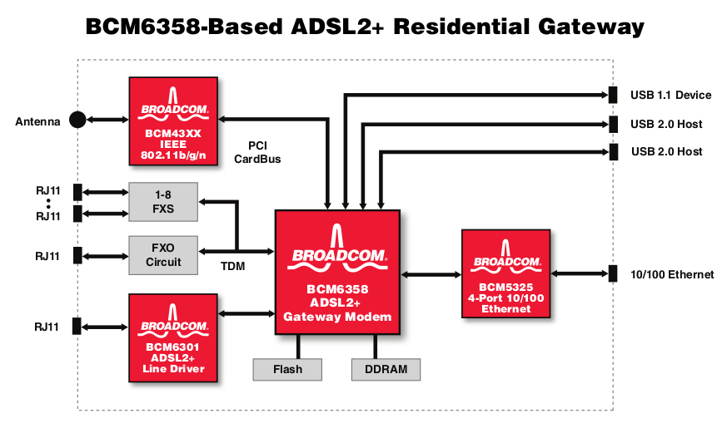
Home Gateway – Broadcom Block Diagram
https://www.datasheets.com/en/datasheet/BCM6358-Broadcom%20Limited-28017805

Slide 5
Home Gateway – Broadcom Block Diagram
Wifi
USB to Mobile
Network
CPU
+
ADSL
Modem
Ethernet
Ports
Switch
ADSL
Tx/Rx
Ethernet
Ports
WAN port
Phone
Line

Slide 6
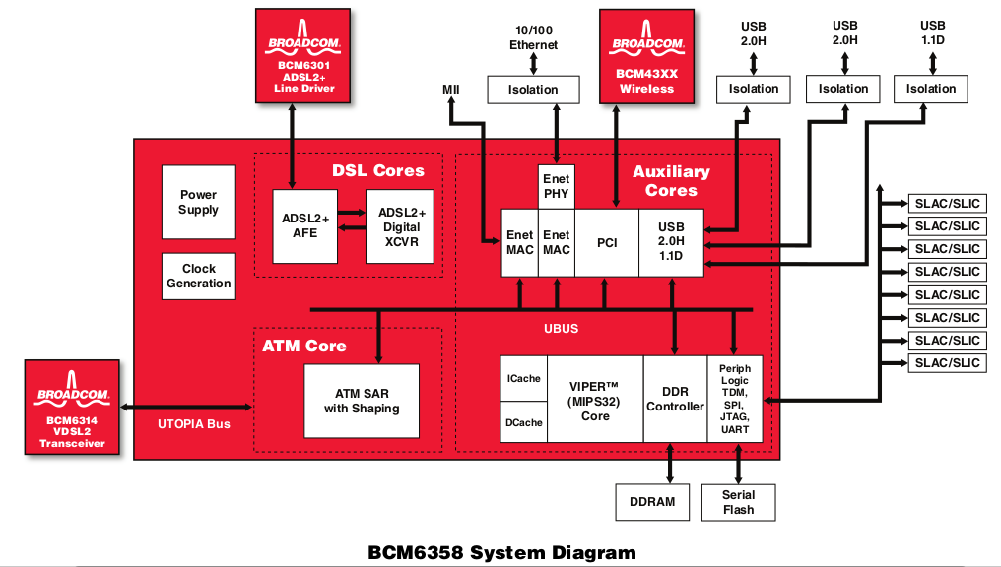
Broadcom BCM6358 Chip
https://www.datasheets.com/en/datasheet/BCM6358-Broadcom%20Limited-28017805

Slide 7
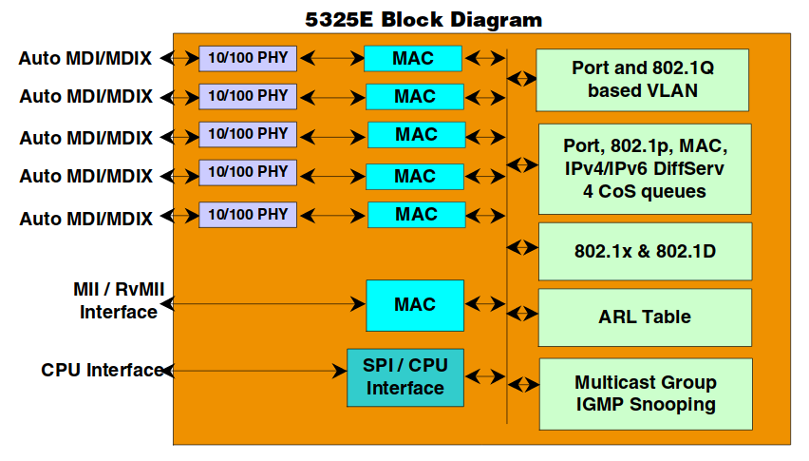
Broadcom Ethernet Switch - BCM5325E
https://openwrt.org/_media/media/datasheets/bcm5325_datasheet.pdf

Slide 8
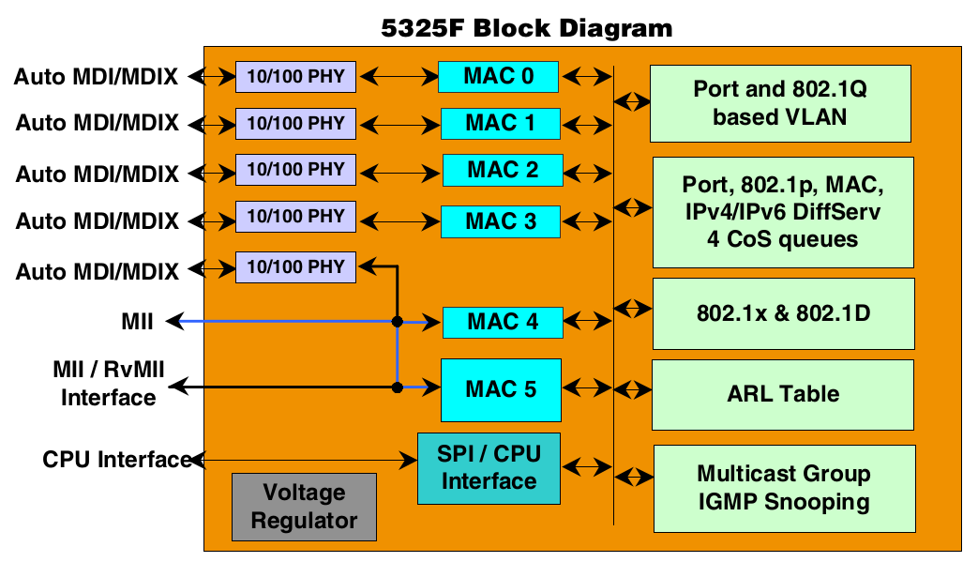
Broadcom BCM5325F – Ethernet + WAN
https://openwrt.org/_media/media/datasheets/bcm5325_datasheet.pdf

Slide 9
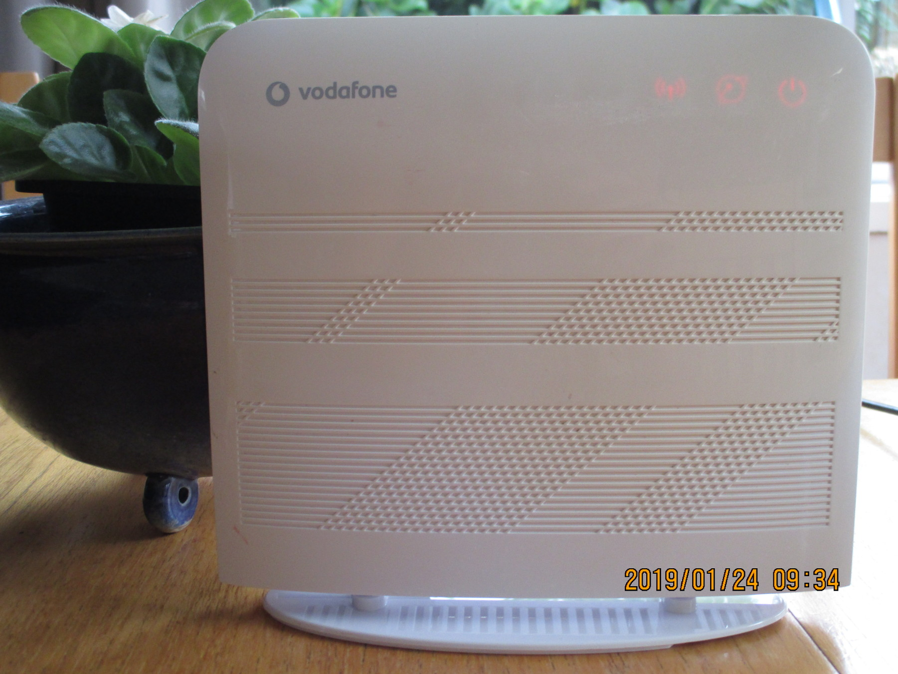
Example: Vodafone / Huawei HG556a A
text

Slide 10
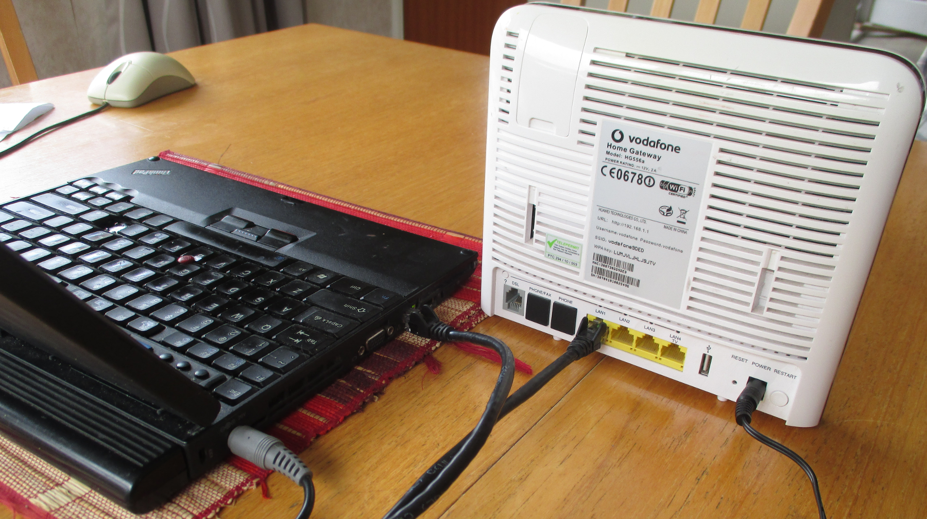
Example: Vodafone / Huawei HG556a A
Ethernet port plugged into laptop

Slide 11
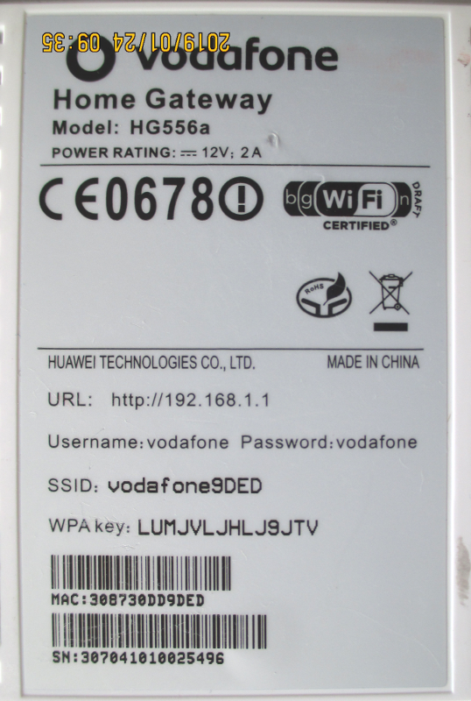
Example: Vodafone / Huawei HG556a A

Slide 12
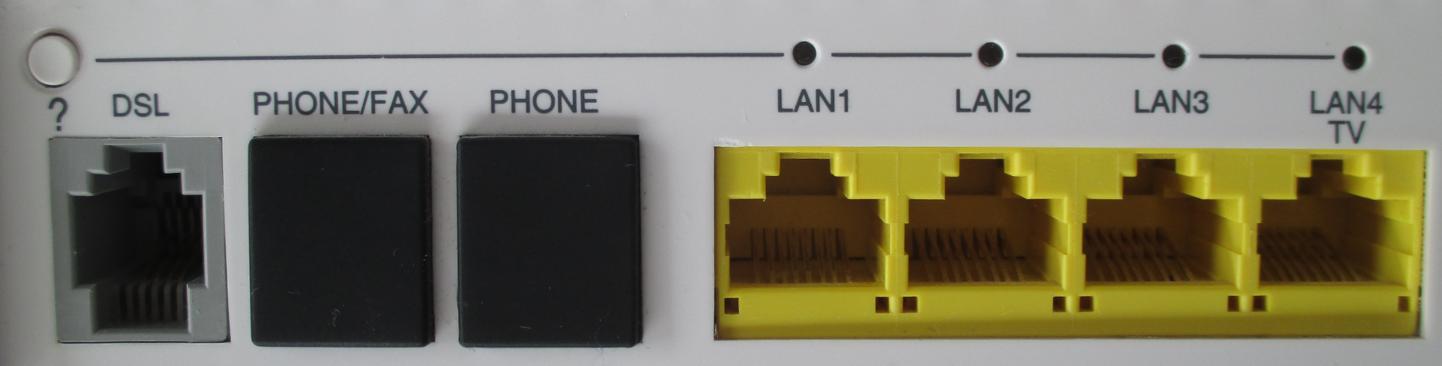
Example: Vodafone / Huawei HG556a A

Slide 13
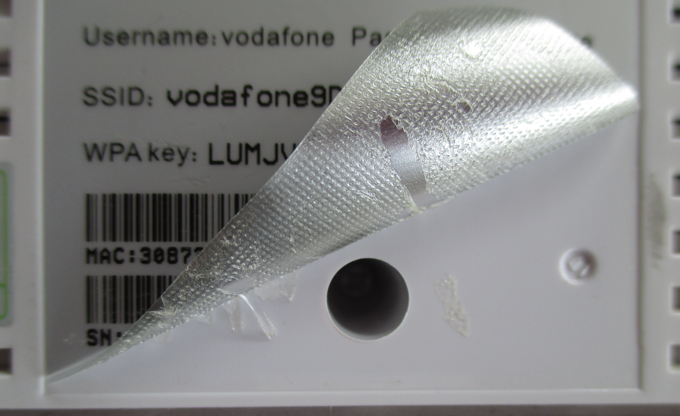
Example: Vodafone / Huawei HG556a A

Slide 14
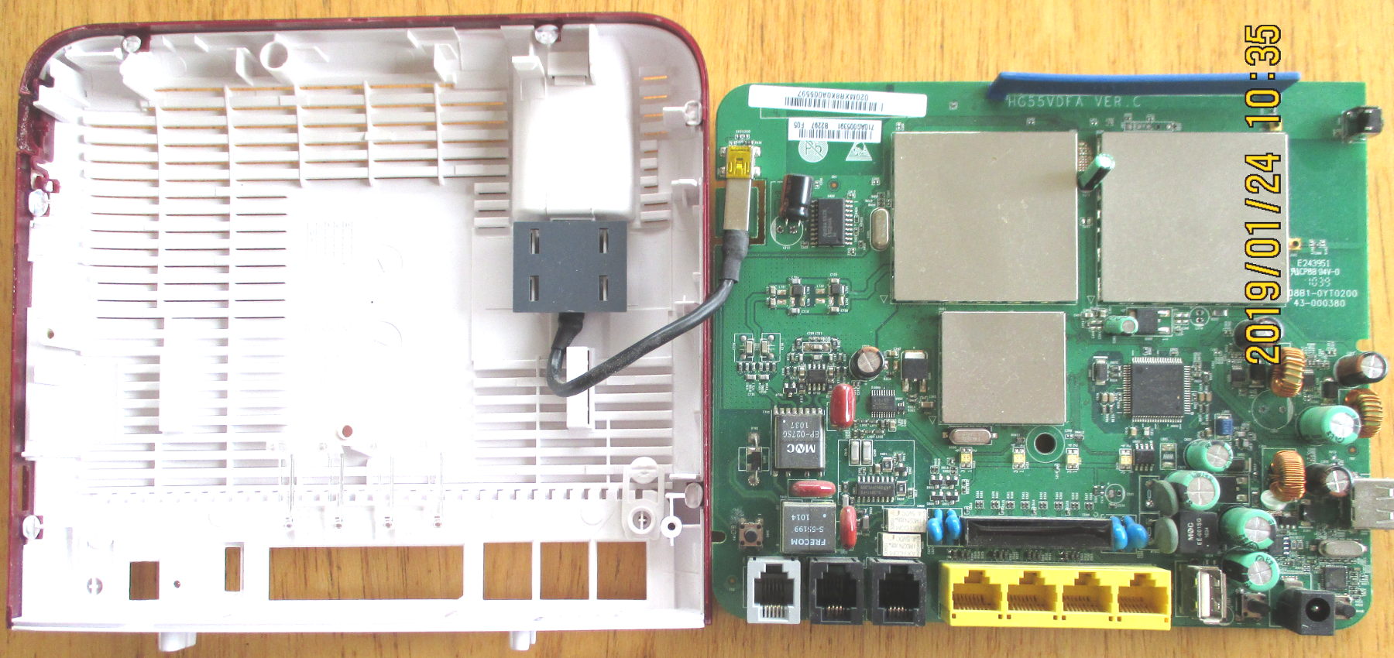
Example: Vodafone / Huawei HG556a A

Slide 15
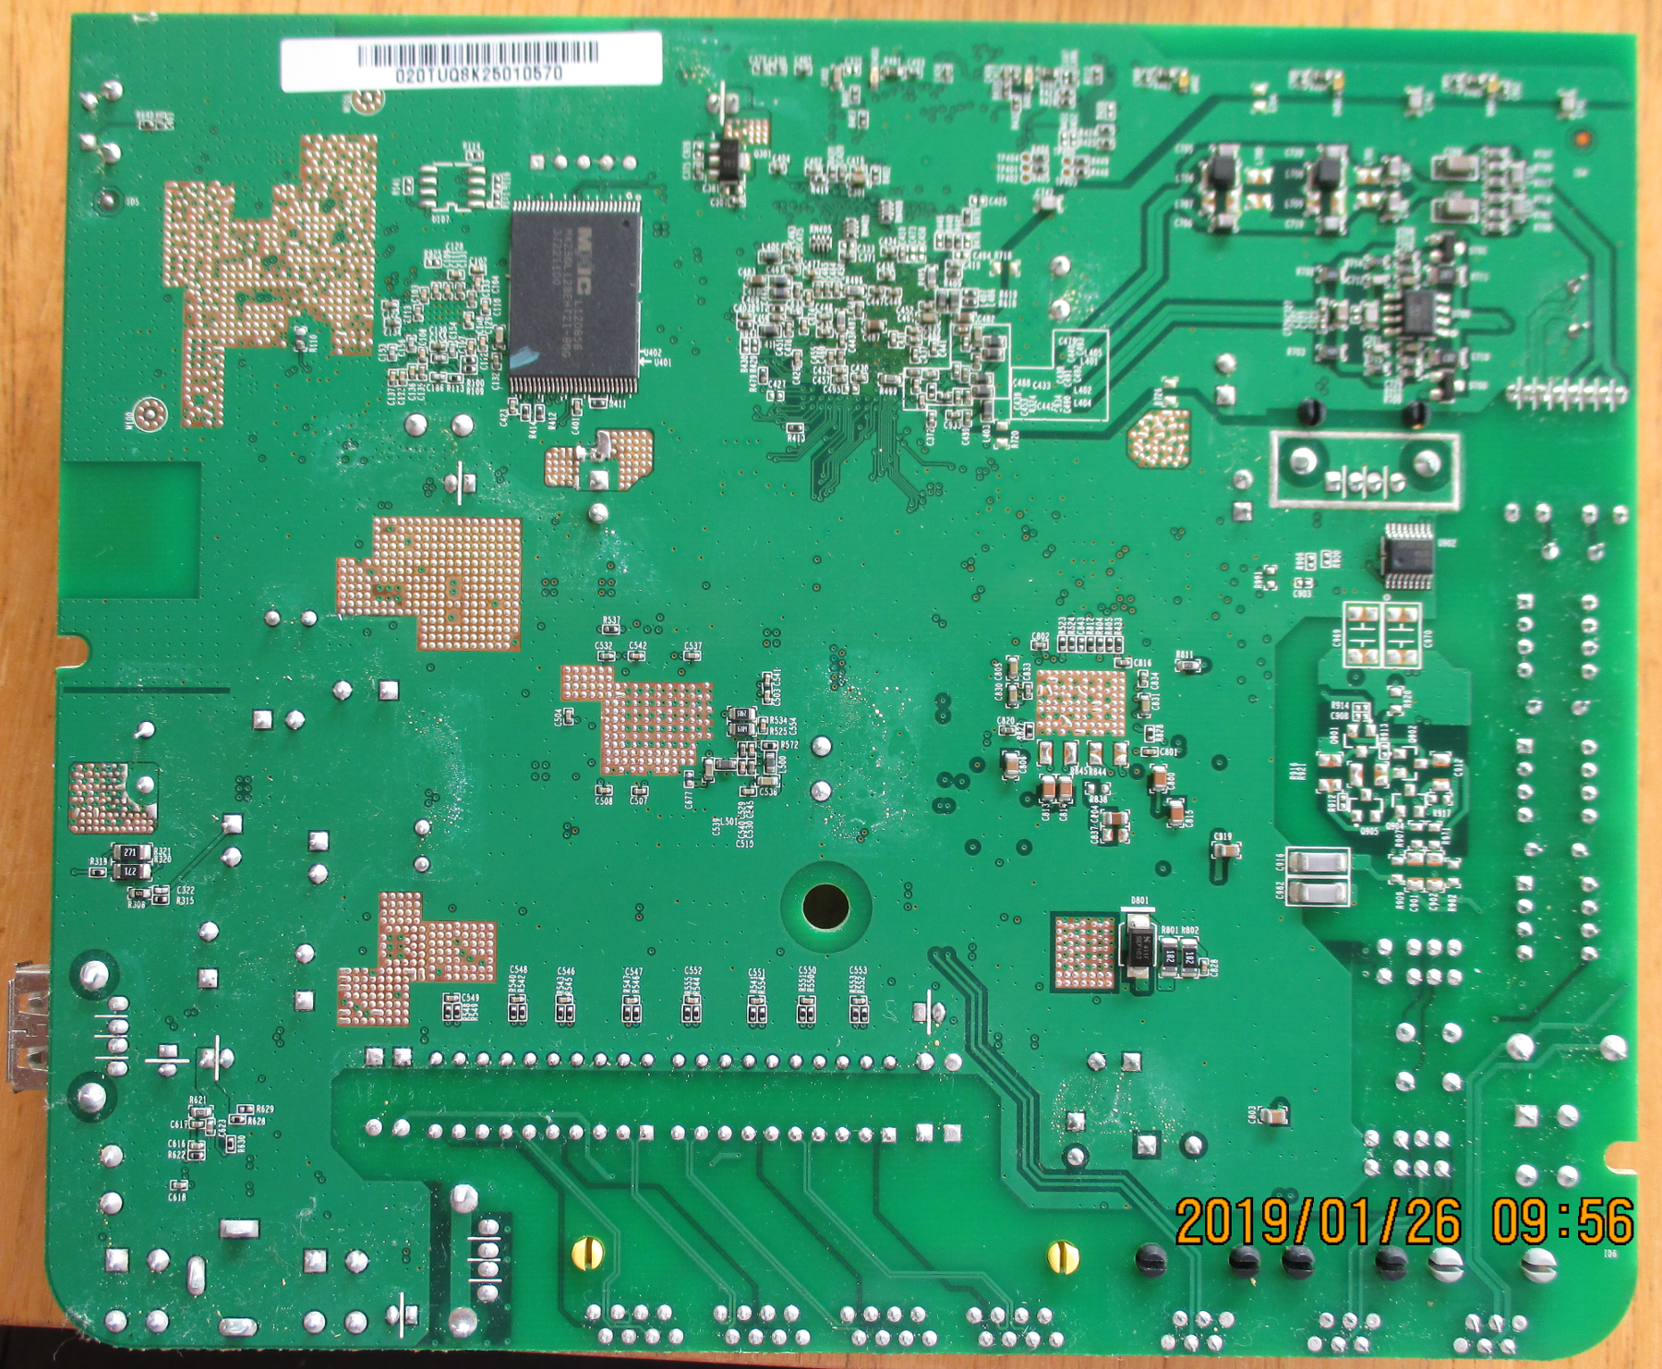
Example: Vodafone / Huawei HG556a A
MX29GL128EH
128Kb Flash RAM

Slide 16
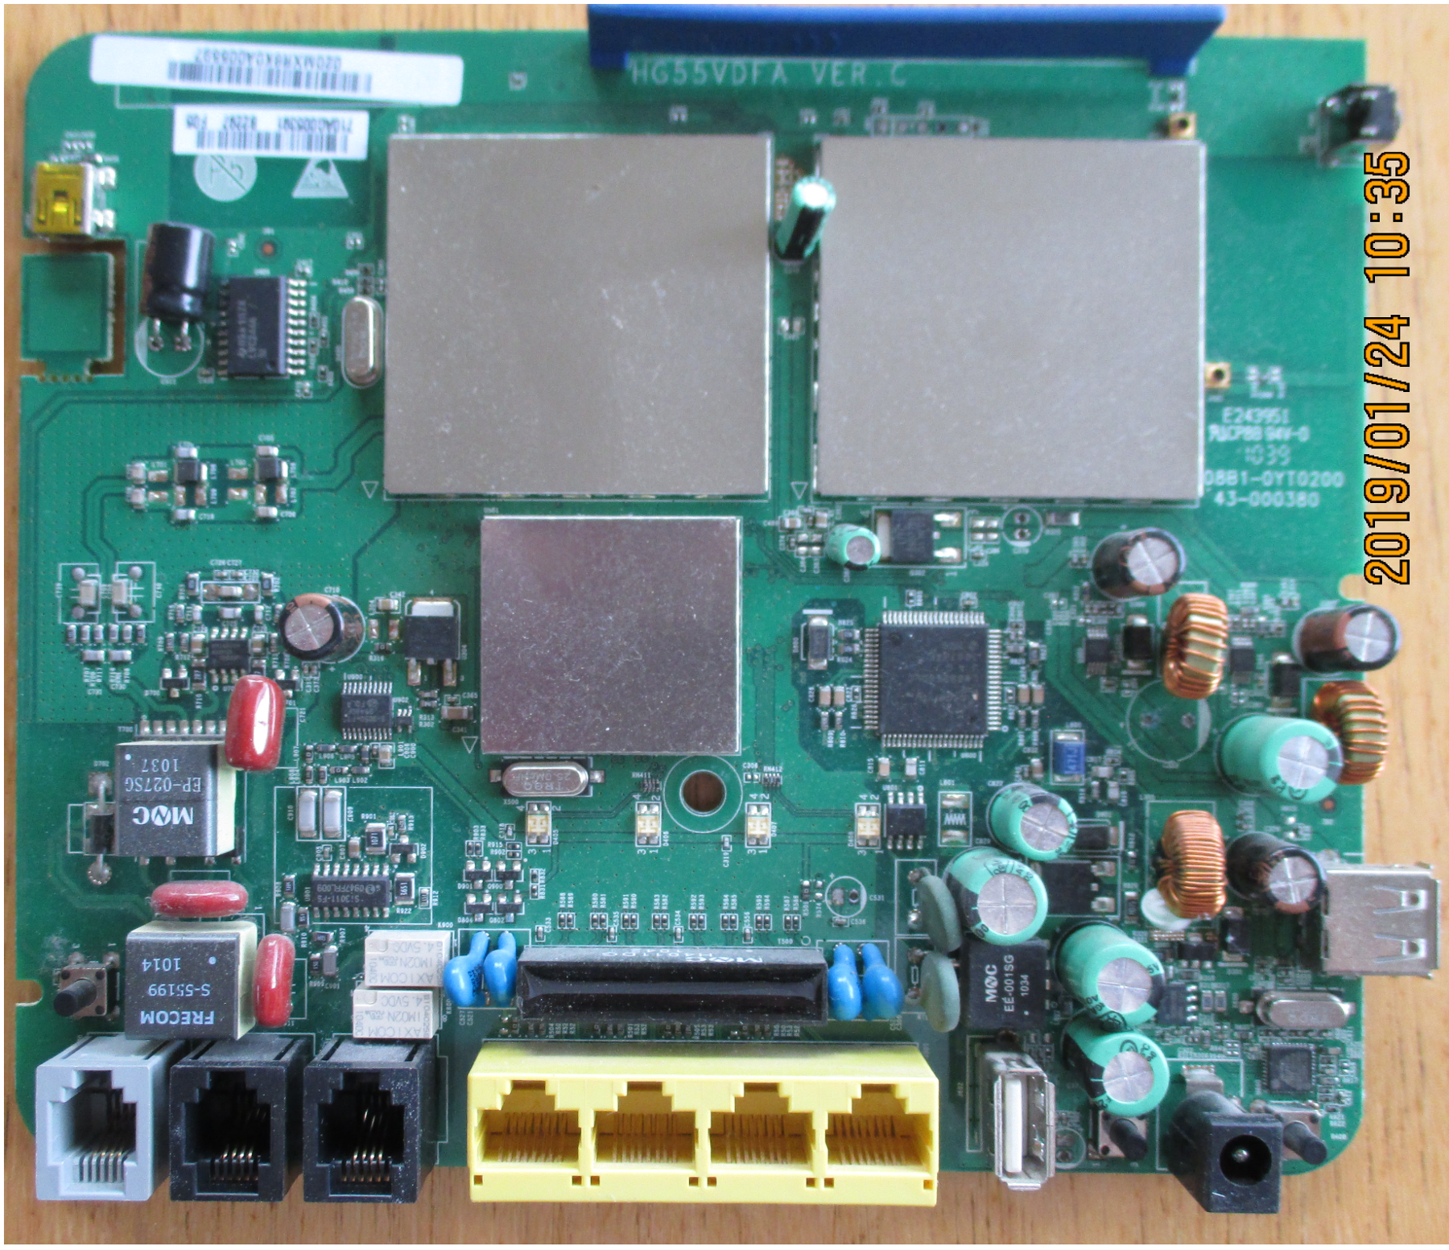
Example: Vodafone / Huawei HG556a A & B
Rev A & B
HG55VDFA VER.C
Wifi: Atheros

Slide 17
OpenWrt
Continues in Part 1a...

